Slide 1

RLC ARQ in 5G NR – Reliable Data Transfer in Acknowledged Mode
Presented by Group 3:
  55984 – Vikas Srivastava
  58622- Harshinie M
  58623 – Shreyash Bhatt
  58624 – Jayavarshini G
  58635 – Yuvaraj P

Slide 2
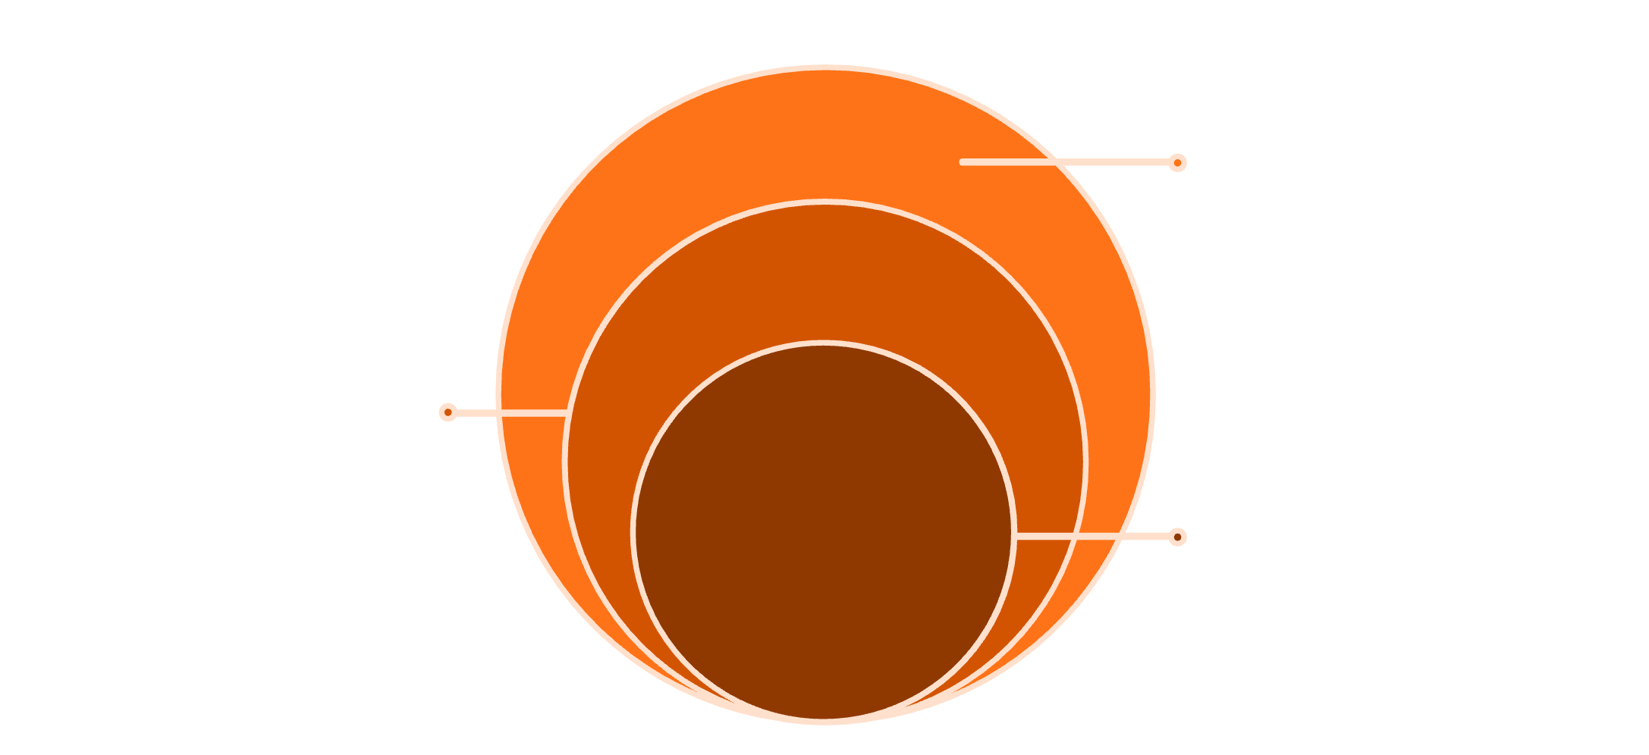
Where RLC ARQ Fits in the 5G Stack
Show protocol stack: PDCP → RLC → MAC → PHY
MAC & PHY
Scheduling, multiplexing, and physical transmission
RLC (ARQ)
Explain where ARQ operates and why RLC AM is needed
Segmentation, reassembly, and ARQ retries
PDCP
ARQ operates at the RLC layer, sitting between PDCP and MAC. RLC Acknowledged Mode (AM) is needed to provide reliable data transfer over wireless links by detecting and recovering from packet losses that occur in the unpredictable wireless channel.
Header compression and ciphering
The 5G NR protocol stack consists of multiple layers working together to ensure reliable data transmission.

Slide 3
What is ARQ in RLC AM?
Define ARQ
Explain ACK/NACK concept
Why ARQ is required over wireless links
ARQ (Automatic Repeat Request) is a protocol mechanism that ensures reliable data delivery by detecting transmission errors and requesting retransmission of lost or corrupted packets.
The receiver sends ACK (Acknowledgment) for successfully received packets and NACK (Negative Acknowledgment) for missing or corrupted packets, triggering retransmission from the sender.
Wireless channels are prone to interference, fading, and signal degradation. ARQ compensates for these impairments by ensuring that lost data is retransmitted, maintaining data integrity and reliability.

Slide 4
RLC AM Header Fields Used in ARQ
The RLC AM header contains several critical fields that enable the ARQ mechanism to function effectively:
1
SN (Sequence Number)
Uniquely identifies each RLC PDU to track transmission order and detect missing packets.
2
P-bit (Poll)
Requests the receiver to send a STATUS report, allowing the transmitter to learn about reception status.
3
SI (Segmentation Info)
Indicates whether the PDU is a complete SDU or a segment of a larger SDU.
4
SO (Segment Offset)
Specifies the position of a segment within the original SDU when segmentation occurs.
5
RF (Re-segmentation Flag)
Indicates whether the PDU is a result of re-segmentation of a previously transmitted PDU.

Slide 5





ARQ Process Flow (Step-by-Step)
Visually show:
1. TX sends PDUs with SN = 0,1,2
The transmitter sends three Protocol Data Units with sequence numbers 0, 1, and 2.
2. RX receives 0 and 2 (1 is missing)
The receiver successfully receives PDUs with SN=0 and SN=2, but SN=1 is lost during transmission.
3. RX sends STATUS PDU with ACK_SN=3 and NACK_SN=1
The receiver generates a STATUS report acknowledging up to SN=3 and indicating SN=1 is missing.
4. TX retransmits SN=1
Upon receiving the STATUS report, the transmitter retransmits the missing PDU with SN=1.
5. RX delivers SDUs in order
After receiving the retransmitted PDU, the receiver can now deliver all SDUs to upper layers in correct sequence.

Slide 6
Sliding Window & Polling Mechanism
TX/RX window
When and why polling happens
The transmitter maintains a transmission window that defines the range of sequence numbers it can send without receiving acknowledgment. The receiver maintains a reception window that defines the range of sequence numbers it expects to receive. These sliding windows move forward as PDUs are acknowledged, enabling continuous data flow while maintaining order.
Polling occurs in several scenarios:
When the transmission window is about to stall
After transmitting a certain number of PDUs
When retransmission buffer reaches a threshold
Periodically to ensure receiver status is known
Polling ensures the transmitter receives timely feedback about reception status, preventing deadlock and enabling efficient retransmission.
P-bit and t-PollRetransmit timer
The P-bit (Poll bit) is set by the transmitter to request a STATUS report from the receiver. The t-PollRetransmit timer is started when a poll is sent and triggers retransmission if no STATUS report is received before timeout.

Slide 7
Retransmission & Re-Segmentation
01
02
03
How TX buffers PDUs
What happens when MAC grant is smaller
Re-segmentation using RF and SO
The transmitter maintains a retransmission buffer that stores copies of all transmitted PDUs until they are acknowledged. This buffer allows the transmitter to quickly retransmit any PDU that the receiver reports as missing, without needing to reconstruct it from upper layer data.
When the MAC layer provides a grant that is smaller than the size of the PDU to be retransmitted, the RLC layer cannot send the entire PDU in one transmission. This situation requires re-segmentation to fit the available transport block size.
Re-segmentation divides a previously transmitted PDU into smaller segments. The RF (Re-segmentation Flag) is set to indicate this is a re-segmented PDU. The SO (Segment Offset) field specifies where each segment belongs within the original PDU, allowing the receiver to correctly reassemble all segments back into the complete PDU.

Slide 8




Summary & Key Takeaways
Summarize ARQ process and benefits
Reliable Data Transfer
Efficient Recovery
Flexible Segmentation
RLC ARQ ensures reliable data delivery over unreliable wireless channels through acknowledgment and retransmission mechanisms.
The combination of sequence numbers, STATUS reports, and sliding windows enables efficient detection and recovery from packet losses.
Re-segmentation capability allows RLC to adapt to varying MAC grant sizes while maintaining reliable delivery.
Timely Feedback
Polling mechanism ensures transmitter receives timely feedback, preventing stalls and optimizing throughput.

Slide 9
CONCLUSION
RLC ARQ in 5G NR Acknowledged Mode is a critical component that bridges the gap between the unreliable nature of wireless transmission and the need for guaranteed data delivery, making it essential for applications requiring high reliability.

Slide 10
THANK YOU

